Slide 1
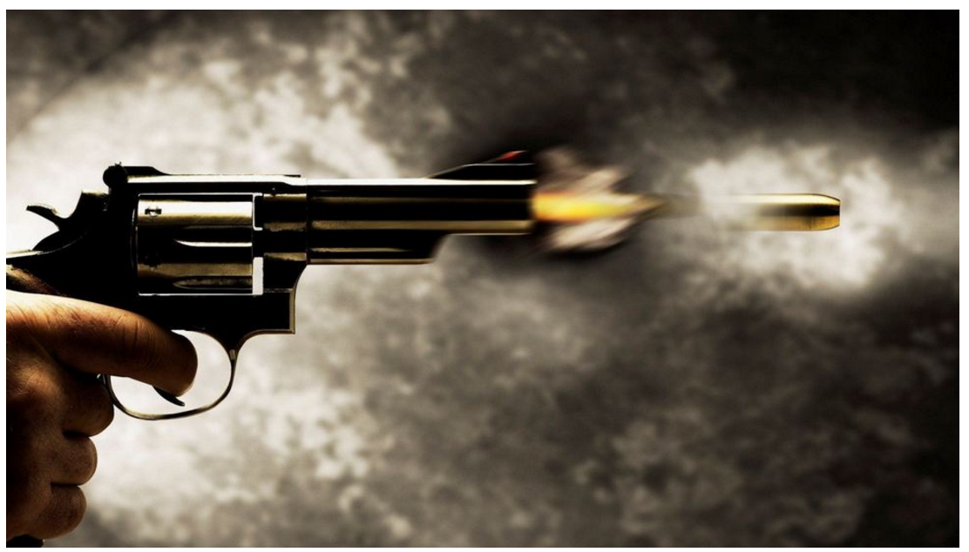
Conceptual question #1
Discuss the following question with your group using the whiteboard as necessary.
If a bullet is fired horizontally, does it actually fly straight? Explain your choice using principles of physics.

Slide 2
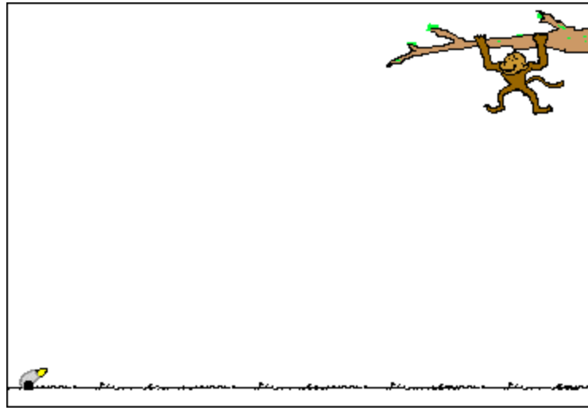
Conceptual Question #2
You’re just a happy monkey on the tree when a hunter appears and is aiming his gun right at you!
In desperation, you thought of a brilliant idea! The idea is to let go of the tree branch exactly when hunter fires his gun. Will you, the poor monkey, survive? Explain your choice using physics principles and writing down any assumptions you made.
You can use numbers to help start you off.

