Slide 1
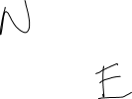
PD-K02
PD-Kinematics
Name the vector below and calculate its horizontal and vertical components of the following vector?

